Slide 1





EMAIL BOT

Slide 2

EMAIL BOT
EMAIL MARKETING IS A HIGHLY VOLATILE ONE. IT UNDERGOES CHANGES EVERY PASSING HOUR RULES AND REGULATIONS ARE CHANGED EVERY SINGLE MOMENT BY EMAIL PROVIDERS. WITH EMAIL BOT, YOU GET AN AUTOMATED PLATFORM THAT USES ARTIFICIAL INTELLIGENCE INORDER TO IDENTIFY THE SPAM CONTENT AND FILTER IT PROPERLY. EACH EMAIL IS SEND USING IP ROTATION TECHNIQUES. WE HAVE 2300 DEDICATED IPS AND POWERFUL SERVERS TO MAKE SURE YOUR MESSAGE REACHES TO POTENTIAL CLIENTS OR CUSTOMERS.

Slide 3

What can an Emailbot do?
An Emailbot processes content and performs actions. You decide what the email bot will analyse and what it should do when. Below is an overview of what it can do.
Forward
The bot forwards emails to people or systems .
Respond
It can respond to any inquiry .
Extract data
Extracts keywords and information from the content .
Connect to API
Can be connected to systems in order to perform actions .
Classify
Categorizes incoming emails by type .
Interpret and understand
Analyses your content and learns what is what.
Identify
Identies with the help of keywords .
Filter and organize
Organizes your e-mails and lters out junk email

Slide 4

What are the benefits of an Emailbot?
Easy to integrate
Our solution is designed to connect and co-ordinate alongside other software and systems.
Highly user-friendly
We are devoted to ensuring that the interface is as userfriendly as possible. No coding or technical background is required to have an Emailbot.
Unlimited capacity
The Emailbot can handle large volumes of incoming e-mails at once, around the clock, without breaks.
Increased productivity
Get things done by allowing repetitive tasks to take care of themselves, so you can focus on other areas.
Get an overview
Gain a good and well-organized overview – all emails are classied completely automatically.

Slide 5

What happens when the bot receives an email?
To be able to handle the email properly, the Emailbot analyses the content via multiple layers of understanding:
1. What type of email is it?
When the Emailbot receives an email, it immediately reads what type of email it is.
Example: Spam, invoice or customer inquiry.
2. To which category does it belong?
The bot identies the essence of the email, e.g., the subject of the complaint. It retrieves information via keywords and machine learning, and understands why the email has been sent.
Examples: Claim, travel expenses, ad sales.
3. What intents does it contain?
We use the word intent to explain an intention or purpose. What is the intention of the sender? What do the sentences tell us? Through training, the bot can learn to read the meaning of sentences and determine whether the email has numerous intents.
Example: “I would like to subscribe to your service” “Can I receive an offer?”
4. What entities are included?
The bot retrieves important information from what we call ‘entities’. The term ‘entity’ is Latin for ‘that which is’, and is a collective term for ‘unit’. Examples: City, date, name, numbers, addresses and time.

Slide 6

How do you get started? Step 1
Training via tagging
To train the language engine, we tag the existing emails.
We tell the bot the type and category of the email, what intents it has, and what kinds of entities are specied.
Once it has been trained with a certain amount of data, the email bot will be able to analyze, interpret, and understand the content itself

Slide 7
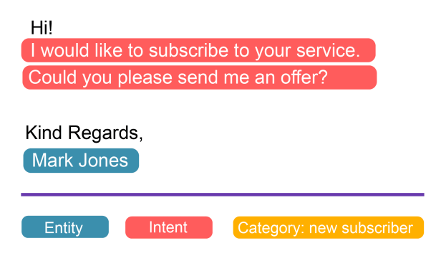

Slide 8

Step 2
You determine the rules and the action flow
Choose what the bot will do with the information.
Set rules and conditions for which actions are to be performed and when.

Slide 9
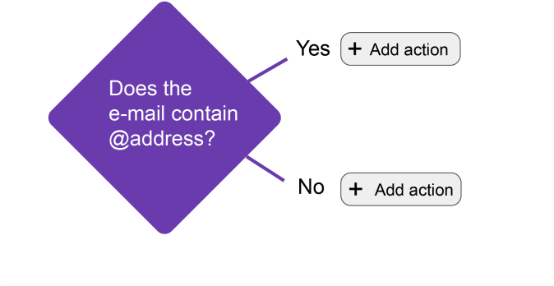

Slide 10

LANGUAGE ENGINE
The Emailbot analyses and makes decisions based on a combination of rules and language engine, also known as Natural Language Understanding.
“ The bot understands the content and improves as it learns.”

